Slide 1
Sales performance Analysis
Exploratory data Analysis of regional and customer trends
Nandini | july 2026

Slide 2
Project Objective
Which regions generate the highest sales
Which customer segments contribute the most revenue
How monthly trends impact sales performance
Actionable recommendations for business growth

Slide 3
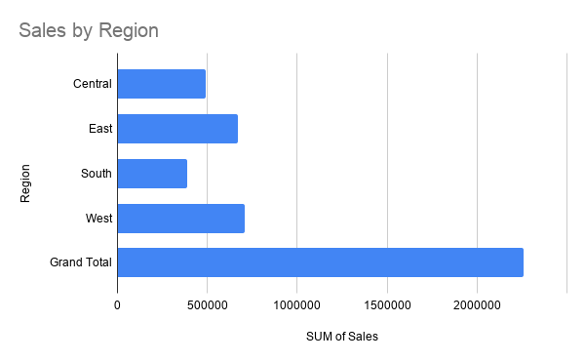
Sales by region
South region has the least sales among all of them
Sales in every region are approximately equivalent with minute differences
So the sales are solely due to the product value rather than it is popular in some regions
The WEST region generates the highest sales at $710219.6845

Slide 4
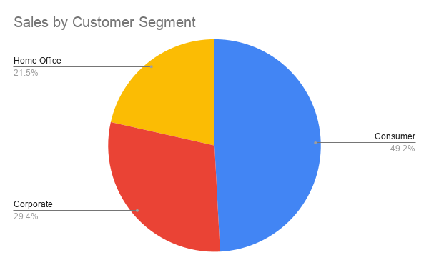
Sales by customer segment
Consumer market is always the biggest so the sales are marketed to right people
The consumer segment contributes the most revenue at $1148060.333

Slide 5
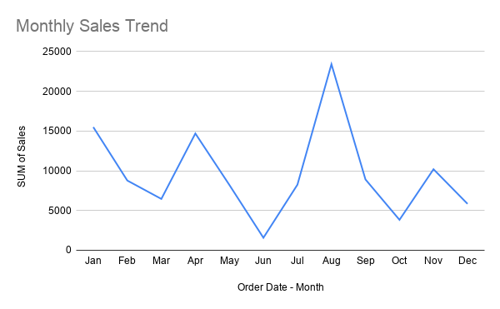
Monthly Sales Trend
Sales are least in June month
So to maintain constant sales the set of manufacturing products should be replaced by seasonal products
Sales peak in August

